Slide 2
System Security CYB 309 Access Control Process
Egena Onu, PhD.
Computer Science Department,
Bingham University.

Slide 3
Access Control Process
Access Control Process governs the granting, preventing, or revoking of access to a resource.
The core of an access control process is the establishment of an access control policy or rule that determines which type of access to assign and when.
To determine an access control policy, the policy owner needs an evaluation of the asset or data – this is to understand the importance of an organization’s asset so that adequate controls can be established.
Then, the asset should be properly marked so that its classification is clear to everyone, and a disposal policy needs to be established for when the access is not needed anymore.

Slide 4
Access Control Process
The initial phase of access control process include:
Asset/data classification
Asset marking
Access policy definition
Data disposal

Slide 5
Asset/Data Classification
Asset or data classification is the process of classifying data based on the risk for the organisation related to a breach on the confidentiality, integrity, and availability of the data.
To protect an asset, an organization first needs to understand how important that asset is.
For example, the unauthorized disclosure of the source code of a product might be more impactful on an organization than the disclosure of a public configuration guide.
The first step in implementing an access control process is to classify assets or data based on the potential damage a breach to the confidentiality, integrity, or availability of that asset or data could cause.

Slide 6
Asset/Data Classification
For example, military and governmental organizations commonly use the following classification definitions:
Top Secret: Unauthorized access to top-secret information would cause grave damage to national security.
Secret: Unauthorized access to secret information would cause severe damage to national security.
Confidential: Unauthorized access to confidential information would cause damage to national security.
Unclassified: Unauthorized access to unclassified information would cause no damage to national security.

Slide 7
Asset/Data Classification
The commercial sector has more variety in the way data classification is done – more specifically, to the label used in the classification.
Commonly used classification labels in the commercial sector are:
Confidential or Proprietary: Unauthorized access to confidential or proprietary information could cause grave damage to the organization. Examples of information or assets that could receive this type of classification include source code and trade secrets.
Private: Unauthorized access to private information could cause severe damage to the organization. Examples of information or assets that could receive this type of classification are human resource information (for example, employee salaries), medical records, and so on.
Sensitive: Unauthorized access to sensitive information could cause some damage to the organization. Examples of information or assets that could receive this type of classification are internal team email, financial information, and so on.
Public: Unauthorized access to public information does not cause any significant damage.

Slide 8
Asset Marking
Once an asset has been classified with a specific category, a mark or label needs to be applied to the asset itself so that the classification level is clear to the user accessing the asset.
Putting a stamp on a document with the label “Top Secret” and watermarking a digital document with the label “Confidential” are examples of the marking process.

Slide 9
Access Control Policy
The next step of an access control process is to establish the access control policy for each asset or data. This will be based on the label the asset received in the classification and marking steps described in the preceding sections.
The access control policy should include information on who can access the asset or data, when, and in which mode.
The access control policy will also describe how the access should be protected, depending on its state which could be any of the following:
Data at rest refers to data that resides in a storage device such as a hard drive, CD or DVD, or magnetic drive. Data is in this state most of its lifetime. Data at rest is usually protected by using strong access controls and encryption.

Slide 10
Access Control Policy
Data in motion refers to data moving between two parties, meaning it is in transit. When in this state, the data is subject to higher risk because it goes outside of the security perimeter where the data owner might not have control. End-to-end encryption and VPN technologies are usually used to protect data in motion.
Data in use refers to data being processed by applications or programs and stored in a temporary or volatile memory such as random access memory (RAM), a CPU register, and so on.

Slide 11
Data Disposal
An access control process should include information on how to dispose of an asset or data once it is not needed anymore, as defined by the organization’s data retention policy.
Data disposal may take several steps and use different technology.
In fact, having a strong process for disposing data is equally important as setting up a process to protect the data when still in use. For example, one type of technique malicious actors use is called dumpster diving.
In simple terms, dumpster divers try to find useful information for an attack by looking in the trash, hoping to find useful documents, network diagrams, and even passwords to access systems.

Slide 12
Data Disposal
Depending on the classification level, data may be subject to sanitization before it can be disposed.
Sanitization methods include the following:
Clearing: This technique should ensure protection against simple and noninvasive data recovery techniques.
Purging: This technique should ensure protection against recovery attempts using state-of-the-art laboratory techniques.
Destroying: This technique should ensure protection against recovery attempts using state-of-the-art laboratory techniques and should also make the storage media unusable.

Slide 13
Types of Access Control
There are several types of access controls. However, they can be classified into three main categories:
Administrative controls
Physical controls
Technical controls
Notes:
For example, a policy that provides information on who is authorized to access a resource and an access list implemented on a firewall to limit access to a resource are two types of access controls. In this case, the policy would be an administrative access control, whereas the access list would be a technical or logical access control.

Slide 14
Administrative Controls
Administrative controls, sometime called management controls, these include the policies, procedures around the definition of access controls, definitions of information classifications, roles and responsibilities, and in general anything that is needed to manage access control from the administrative point of view.
Administrative controls are usually directly overseen by senior management. Administrative controls include the following subcategories:
Operational and security policies and procedures
Policies around personnel or employee security
Security education and training
Auditing and monitoring policies

Slide 15
Administrative Controls
Operational and security policies and procedures
These could include policies about change control, vulnerability management, information classification, product lifecycle management, and so on.
Policies around personnel or employee security
These could include the level of clearance needed to access specific information, background checks on new hires, and so on.
Generally, this category includes policies on all the controls that need to be in place before access is granted to a resource.
Security education and training
This subcategory includes all the policies and efforts needed to implement end-user training and education.
Auditing and monitoring policies
These might include policies on how to perform employee monitoring, system and compliance auditing, and so on.

Slide 16
Physical Controls
This type of control is aimed at protecting the physical boundaries and ensuring employee safety.
These types of controls are usually deployed in various layers in accordance to the concept of defense.
Examples of these controls are the fence at the entrance of the building, fire alarms, surveillance systems, and security guards.
Physical access controls are usually designed by defining security zones (for example, Data Center) and implementing physical controls, depending on the classification of the assets.
For example, entering the data center area may require additional privileges versus entering the building facilities.

Slide 17
Technical Controls
These controls, also called logical controls, are all the logical and technological systems in place to implement and enforce the controls included in the security policy and, in general, dictated by the administrative controls.
A firewall, an intrusion detection system, a remote access server, an identity management system, and encryption are all examples of technical controls.

Slide 18
Access Control Models
An access control model is a conceptual framework that describes how the access control should be designed (that is, how a subject interacts with an object).
There are several access control models; for example, access controls that authorize access to resources based on the identity of the subject are called identity-based access controls (IBACs).
However, any access controls can usually be categorized as discretionary access controls and nondiscretionary access controls.
The key differentiator between the two is based on the entity that decides how to enforce a policy.

Slide 19
Access Control Models
In discretionary access controls, the object owner has the right to decide who can access an object.
Nondiscretionary access control is a broad category that includes all types of access control models where the authorization is decided by a central administrator instead of by the object owner.
The common types of access control mechanisms considered here are:
Discretionary access control (DAC)
Mandatory access control (MAC)
Role-based access control (RBAC)
Attribute-based access control (ABAC)

Slide 20
Discretional Access Control
In a DAC model, each resource has a clearly identified owner.
For example, a user creating a file becomes the owner of that file. The owner of a resource can decide at his discretion to allow other users or subjects access to that resource.
The owner’s discretion is the main characteristic of DAC. When assigning permission, the owner should comply with the organization’s security policy; however, security policy compliance is not enforced by the operating system.
When the owner allows access to a different user, he would also set access permission (for example, read, write, or execute) for the resource specific to the user.

Slide 21
Discretional Access Control
In a DAC model, users can also be organized in groups. The owner can grant access to a resource to the entire group instead of the individual user.
Also, permission attributes are assigned to a resource for the specific group.
A simple way to implement the DAC model is to use an access control list that is associated with each object.
Most of the commercial operating systems in use today implement a form of the DAC model.

Slide 22
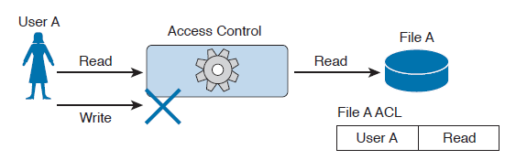
Discretional Access Control
In a DAC model, users can also be organized in groups. The owner can grant access to a resource to the entire group instead of the individual user.
Also, permission attributes are assigned to a resource for the specific group.
A simple way to implement the DAC model is to use an access control list that is associated with each object.
Most of the commercial operating systems in use today implement a form of the DAC model.

Slide 23
Discretional Access Control
Drawbacks of DAC
One of the drawbacks of using a DAC model is that the security policy is left to the discretion of the data owner, and the security administrator has limited control over it.
Additionally, with the number of subjects (users, processes, programs, and so on) accessing a large number of objects, maintaining permissions by respecting the need-to-know and least-privileges concepts becomes a complex administrative task.
Authorization creep or privilege creep describes an issue that’s common in a large organization of privileges being assigned to a user and never being revoked when the user does not need them anymore, which goes against the need-to-know and least-privileges principles.
Notes:
With discretionary access controls, authorization is decided by the owner of the object.
In a DAC system, access permissions are associated with the object.
Access control is usually enforced with access control lists.

Slide 24
Mandatory Access Control
In a MAC model, the access authorization is provided by the operating system itself, and the owner has no control over who can access the resource.
Each resource receives a sensitivity or security label that is determined during the classification steps outlined in the previous sections and includes two components:
The security classification of the object.
The compartment or category to which the object belongs.
For example, a file can be given the security classification “Top Secret” and be associated with the categories Engineering, ProjectA, and TopicB.
A label is also attached to each subject and indicates the clearance level of that subject.

Slide 25
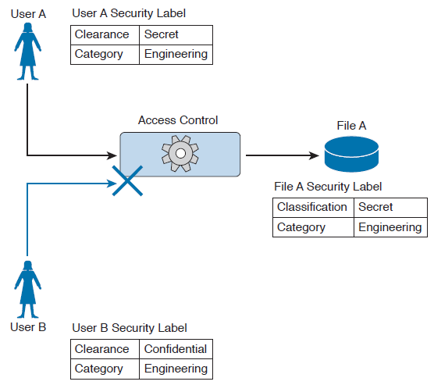
Mandatory Access Control
In a MAC model, the access authorization is provided by the operating system itself, and the owner has no control over who can access the resource.
Each resource receives a sensitivity or security label that is determined during the classification steps outlined in the previous sections and includes two components:
The security classification of the object.
The compartment or category to which the object belongs.
For example, a file can be given the security classification “Top Secret” and be associated with the categories Engineering, ProjectA, and TopicB.
A label is also attached to each subject and indicates the clearance level of that subject.

Slide 26
Mandatory Access Control
Examples of security classifications are:
For military and governmental environments
Top Secret
Secret
Confidential, and Unclassified; and
Confidential,
For the commercial sector:
Private
Sensitive, and
Public.
Categories, on the other hand, can be anything that is meaningful for the organization. These can be workgroup, projects, business units, and so on.

Slide 27
Mandatory Access Control
A system using MAC model would authorize access to an object only if a subject has a label that is equal to or, for hierarchical systems, superior to the label attached to the object.
In a hierarchical system, a label is superior if it has the same or higher classification and includes all categories included in the object’s security label.
Systems based on a MAC model are considered more secure than systems based on a DAC model because the policy is enforced at the operating system, thus reducing the risk of mishandled permissions.
The drawback of a MAC-based system, however, is that it does not offer the same degree of flexibility offered by a DAC-based system.
Due to the issues of less flexibility and more complicated administration, MAC systems have historically been used in environments where high security is needed, such as in a military environment.
Regardless, MAC-based systems are being used increasingly in the commercial sector. SELinux is an example of an operating system that implements the MAC model .
Notes:
With mandatory access controls, the operating system or policy enforcer decides on whether to grant access.
The data owner does not have control and cannot decide to grant access to a resource.
The security policy is enforced by using security labels.

Slide 28
Role-Based Access Control
The RBAC model uses a subject role to make authorization decisions.
Each subject needs to be assigned to a role; however, the assignment is done by the system administrator. This is called user assignment (UA).
Each role is then assigned permission over an object. This is called permission assignment (PA).
The RBAC model greatly improves scalability and simplifies administration because a subject can just be assigned to a role without the permission over an object needing to be changed.
For example, when a user changes jobs or roles, he is simply removed from that role, instead of having permissions removed for all the objects that user was interacting with before the change.

Slide 29
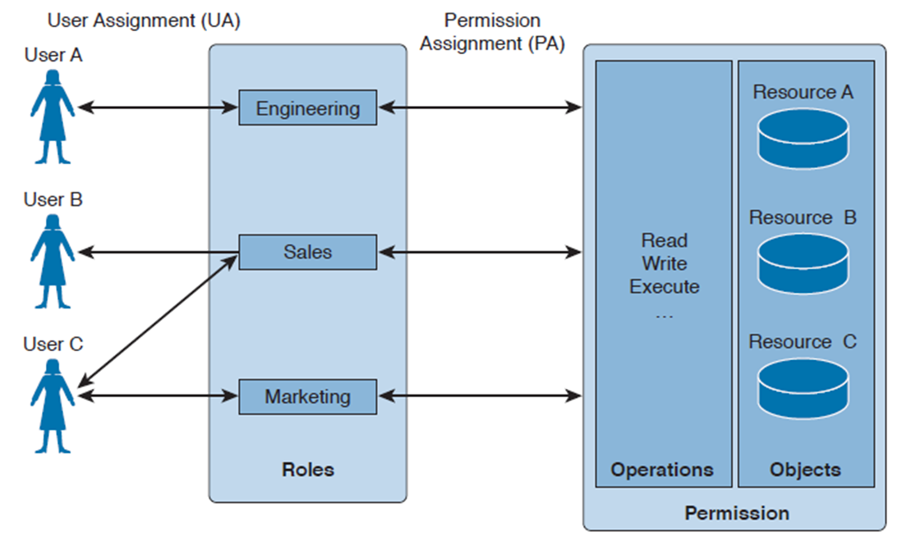
Role-Based Access Control
The RBAC model uses a subject role to make authorization decisions.
Each subject needs to be assigned to a role; however, the assignment is done by the system administrator. This is called user assignment (UA).
Each role is then assigned permission over an object. This is called permission assignment (PA).
The RBAC model greatly improves scalability and simplifies administration because a subject can just be assigned to a role without the permission over an object needing to be changed.
For example, when a user changes jobs or roles, he is simply removed from that role, instead of having permissions removed for all the objects that user was interacting with before the change.

Slide 30
Role-Based Access Control
The RBAC model uses a subject role to make authorization decisions.
Each subject needs to be assigned to a role; however, the assignment is done by the system administrator. This is called user assignment (UA).
Each role is then assigned permission over an object. This is called permission assignment (PA).
The RBAC model greatly improves scalability and simplifies administration because a subject can just be assigned to a role without the permission over an object needing to be changed.
For example, when a user changes jobs or roles, he is simply removed from that role, instead of having permissions removed for all the objects that user was interacting with before the change.

Slide 31
Role-Based Access Control
A subject can be assigned to several roles, and a role can include multiple subjects.
In the same way, a role can have multiple permissions, and the same permissions can be assigned to multiple roles.
This creates a many-to-many relationship. The RBAC model supports the principles of least privileges, separation of duties, and data abstraction.
The least-privileges principle is provided by configuring the RBAC system to assign only the privileges that are needed to execute a specific task to a role.
Separation of duties is obtained by configuring the system so that two roles that are mutually exclusive are needed to finish a task.
Data abstraction is achieved by using abstract permissions (for example, open and close if the object is a lock instead of the typical read, write, and execute).

Slide 32
Components of Role-Based Access Control
According to the RBAC standard proposed by National Institute of Standards and Technology (NIST), there are three components of the RBAC model.
These are:
Core RABC
Hierarchical RBAC
Constraint RBAC

Slide 33
Components of Role-Based Access Control
Core RBAC
This is the fundamental component of the RBAC model, and it implements the basic authorization based on the user roles.
A session in the context of RBAC is the way a subject or user activates a subset of roles.
For example, if a user is assigned to two roles (guest and administrator), then using a session as guest will activate only the permission given to the guest role.
Using a session as administrator will give the user permission based on the administrator role.

Slide 34
Components of Role-Based Access Control
Hierarchical RBAC
This component introduces hierarchy within the RBAC model and is added on top of the core RBAC.
This component facilitates the mapping to an organization, which is usually structured in a hierarchical way.
In simple terms, hierarchical RBAC allows permission inheritance from one role to the other.
For example, the head of multiple business units may inherit all the permissions assigned to each business unit, plus have the permission assigned to the “head of business units” role itself.
Within hierarchical RBAC, two models are defined:
General role hierarchy, which allows for multiple role inheritance, and
Llimited role hierarchy, when the model includes restriction on the type of inheritance.

Slide 35
Components of Role-Based Access Control
Constraint RBAC
This component introduces the concept of separation of duties.
The main goal of this component is to avoid collusion and fraud by making sure that more than one role is needed to complete a specific task.
It comes in two subcomponents:
Static Separation of Duty (SSoD)
Dynamic Separation of Duty (DSoD)

Slide 36
Components of Role-Based Access Control
Constraint RBAC
Static Separation of Duty (SSoD)
This subcomponent puts constraints on the assignment of a user to a role. For example, the same user whose role is to implement the code of a product should not also be part of the auditor or assurance role.
If this component is built on top of a hierarchical RBAC, it will take permission inheritance in consideration when the constraint is formulated.
Dynamic Separation of Duty (DSoD)
This subcomponent also limits the subject or user access to certain permissions; however, it does so in a dynamic way during a user session rather than forbidding a user/role relationship.
That is, the DSoD uses a session to regulate which permissions are available to a user.
For example, a user could be in the role of code implementer and the role of code auditor, but will not be able to get permission as code auditor for code that he implemented himself.
Notes:
Although the RBAC model offers higher scalability than a DAC-based system, in complex organizations the RBAC model would lead to a great expansion of roles, which would increase the administration and management burden. This is one of the drawbacks of this model.

Slide 37
Attribute-Based Access Control
Attribute-based access control (ABAC) is a further evolution in access control models that takes into consideration factors besides identity or role.
These factors could include the location of access, time or temporal constraints, the level of risk or threat, and so on.
With the ABAC model, the authorization decision is based on attributes assigned to subjects and objects, environmental conditions, and a set of policies linked to these attributes and conditions.
Attributes are defined as characteristics that belong to a subject (user), object (resource), or environment.
For example, a subject attribute could be name, nationality, organization, role, ID, security clearance, and so on.
Examples of object attributes are name, owner, data creation, and so on.

Slide 38
Attribute-Based Access Control
Environment conditions are contextual information associated with the access request.
Location of the access, time of the access, and the threat level are all examples of environmental attributes.
Every object should also be associated with at least one policy that regulates which operations a subject with certain attributes, given some environmental constraints, can perform on the object.
For example, a policy could be formulated as “all Engineers who work in the Security Business Unit and are assigned to the Next-Gen Firewall Project are allowed to Read and Write all the Design Documents in the Next-Gen Firewall Project folder when connecting from Building A.”

Slide 39
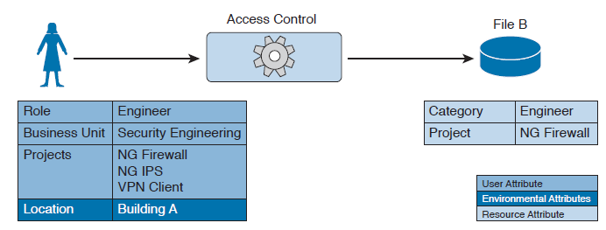
Attribute-Based Access Control
Environment conditions are contextual information associated with the access request.
Location of the access, time of the access, and the threat level are all examples of environmental attributes.
Every object should also be associated with at least one policy that regulates which operations a subject with certain attributes, given some environmental constraints, can perform on the object.
For example, a policy could be formulated as “all Engineers who work in the Security Business Unit and are assigned to the Next-Gen Firewall Project are allowed to Read and Write all the Design Documents in the Next-Gen Firewall Project folder when connecting from Building A.”

Slide 40
Attribute-Based Access Control
Environment conditions are contextual information associated with the access request.
Location of the access, time of the access, and the threat level are all examples of environmental attributes.
Every object should also be associated with at least one policy that regulates which operations a subject with certain attributes, given some environmental constraints, can perform on the object.
For example, a policy could be formulated as “all Engineers who work in the Security Business Unit and are assigned to the Next-Gen Firewall Project are allowed to Read and Write all the Design Documents in the Next-Gen Firewall Project folder when connecting from Building A.”

Slide 41
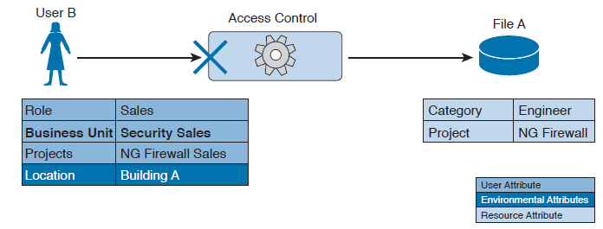
Attribute-Based Access Control
Environment conditions are contextual information associated with the access request.
Location of the access, time of the access, and the threat level are all examples of environmental attributes.
Every object should also be associated with at least one policy that regulates which operations a subject with certain attributes, given some environmental constraints, can perform on the object.
For example, a policy could be formulated as “all Engineers who work in the Security Business Unit and are assigned to the Next-Gen Firewall Project are allowed to Read and Write all the Design Documents in the Next-Gen Firewall Project folder when connecting from Building A.”

Slide 42
Attribute-Based Access Control
Environment conditions are contextual information associated with the access request.
Location of the access, time of the access, and the threat level are all examples of environmental attributes.
Every object should also be associated with at least one policy that regulates which operations a subject with certain attributes, given some environmental constraints, can perform on the object.
For example, a policy could be formulated as “all Engineers who work in the Security Business Unit and are assigned to the Next-Gen Firewall Project are allowed to Read and Write all the Design Documents in the Next-Gen Firewall Project folder when connecting from Building A.”

Slide 43
Questions!

